Slide 1
Chapter 15 : Concurrency Control

Slide 2
Chapter 15: Concurrency Control
Lock-Based Protocols
Timestamp-Based Protocols
Validation-Based Protocols

Slide 3
Concurrent Schedules
Advantage of Concurrent Schedules
Problem associated with the execution of concurrent schedules
    Lost Update
    Dirty Read
    Incorrect Summary

Slide 4
Concurrency Protocols
Goal: Generates Concurrent Schedules
Should satisfy following facts:
Schedule is serializable : Conflict or View serializable
Recoverable
Cascade-less
Increase the level of concurrency (To improve system performance)
Reduce the protocol overhead

Slide 5
Lock based protocol
Lock Mechanism
  exclusive (X) for Write operation
  shared (S) for Read operation
Concurrency control Manager
lock-X instruction
lock-S instruction
Notes:
Lock mechanism; Lock instruction, CC manager, Lock-compatibility matrix

Slide 6
Lock-Based Protocols
A lock is a mechanism to control concurrent access to a data item
It is a variable associated with a data item in the database and describes the status of the item w.r.t. possible operations that can be applied on to item.
Generally there is one lock for each item.
Binary Locks: can have two states or values: locked and unlocked (1 and 0)
Data items can be locked in two modes :
1. exclusive (X) mode. Data item can be both read as well as
written. X-lock is requested using lock-X instruction.
2. shared (S) mode. Data item can only be read. S-lock is
requested using lock-S instruction.
Lock requests are made to concurrency-control manager. Transaction can proceed only after request is granted.

Slide 7

Lock-Based Protocols (Cont.)
Lock-compatibility matrix
A transaction may be granted a lock on an item if the requested lock is compatible with locks already held on the item by other transactions
Any number of transactions can hold shared locks on an item,
  but if any transaction holds an exclusive on the item no other transaction may hold any lock on the item.
If a lock cannot be granted, the requesting transaction is made to wait till all incompatible locks held by other transactions have been released. The lock is then granted.

Slide 8
Lock-Based Protocols (Cont.)
Example of a transaction performing locking:
T₂: lock-S(A);
read (A);
unlock(A);
lock-S(B);
read (B);
unlock(B);
display(A+B)
May lead to incorrect Summary Problem
Locking as above is not sufficient to guarantee serializability — if A and B get updated in-between the read of A and B, the displayed sum would be wrong.
A locking protocol is a set of rules followed by all transactions while requesting and releasing locks. Locking protocols restrict the set of possible schedules.
T1
Notes:
Explain each statement with example. Example another transaction comes in between unloack ( A) and lock(B)
And modifies the A and B which leads to incorrect summary. So solution is …. 2 phase locking..

Slide 9
The Two-Phase Locking Protocol
This is a protocol which ensures conflict-serializable schedules.
Phase 1: Growing Phase
  transaction may obtain locks
  transaction may not release locks
Phase 2: Shrinking Phase
  transaction may release locks
  transaction may not obtain locks
The protocol assures serializability.
It can be proved that the transactions can be serialized in the order of their lock points (i.e. the point where a transaction acquired its final lock).

Slide 10

Pitfalls of Lock-Based Protocols
Consider the partial schedule
Neither T₃ nor T₄ can make progress — executing lock-x(B) causes T₄ to wait for T₃ to release its lock on B, while executing lock-X(A) causes T₃ to wait for T₄ to release its lock on A.
Such a situation is called a deadlock.
  To handle a deadlock one of T₃ or T₄ must be rolled back
  and its locks released.

Slide 11
Pitfalls of Lock-Based Protocols (Cont.)
The potential for deadlock exists in most locking protocols. Deadlocks are a necessary evil.
Starvation is also possible if concurrency control manager is badly designed. For example:
  A transaction may be waiting for an X-lock on an item, while a sequence of other transactions request and are granted an S-lock on the same item.
  The same transaction is repeatedly rolled back due to deadlocks.
Concurrency control manager can be designed to prevent starvation.

Slide 12

Example for Starvation
T1 T2 T3 T4
S(A)
X(A) // Waiting
S(A)
C;
S(A)
C
C; // T1 resumes
Notes:
Solution : threshold

Slide 13
The Two-Phase Locking Protocol (Cont.)
Cascading roll-back is possible under two-phase locking.
      T1 T2
        X(A)
        UN(A)
        X(A)
        Aborts
Solution: strict two-phase locking:
  Here a transaction must hold all its exclusive locks till it commits/aborts. After commit it must unlock.
Rigorous two-phase locking is even stricter: here all locks are held till commit/abort. In this protocol transactions can be serialized in the order in which they commit.
Notes:
Ex for cascading rollback: T1 T2 Solution is Strict 2PL protocol.
X(A)
UN(A)
X(A)
Aborts

Slide 14
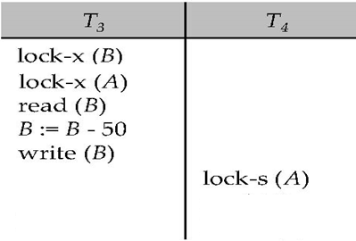
Static/ Conservative 2PL protocol
Deadlock:
Solution: Static/ Conservative 2PL protocol
  Gets Lock in Atomic Manner
No Deadlock
Reduces the concurrency level
Notes:
Strict and rigorous are thinking about release of locks, but still there is a Deadlock situation so solution is Atomic manner of handling the locks.

Slide 15
Lock Conversions
  To improve the concurrency level
Two-phase locking with lock conversions:
– First Phase:
  can acquire a lock-R on item
  can acquire a lock-W on item
  can convert a lock-R to a lock-W (upgrade)
– Second Phase:
  can release a lock-R
  can release a lock-W
  can convert a lock-W to a lock-R (downgrade)
Notes:
This protocol assures serializability. But still relies on the programmer to insert the various locking instructions.

Slide 16
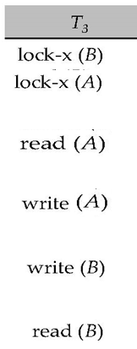
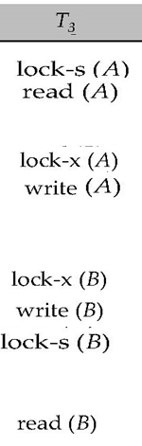
Lock Conversions
(upgrade)
(downgrade)

Slide 17
Automatic Acquisition of Locks
A transaction T_{i} issues the standard read/write instruction, without explicit locking calls.
The operation read(D) is processed as:
if T_{i} has a lock on D
then
read(D)
else begin
if necessary wait until no other
transaction has a lock-W on D
grant T_{i} a lock-R on D;
read(D)
end

Slide 18
Automatic Acquisition of Locks (Cont.)
write(D) is processed as:
if T_{i} has a lock-W on D
then
write(D)
else begin
if necessary wait until no other trans. has any lock on D,
if T_{i} has a lock-R on D
then
upgrade lock on D to lock-W
else
grant T_{i} a lock-W on D
write(D)
end;
All locks are released after commit or abort

Slide 19

Deadlock Handling
Schedule with deadlock

Slide 20
Deadlock Handling
System is deadlocked if there is a set of transactions such that every transaction in the set is waiting for another transaction in the set.
Deadlock prevention protocols ensure that the system will never enter into a deadlock state.
Some prevention strategies :
  Require that each transaction locks all its data items before it begins execution (predeclaration or conservative two phase locking).
  Impose partial ordering of all data items and require that a transaction can lock data items only in the order specified by the partial order (graph-based protocol)

Slide 21
More Deadlock Prevention Strategies
Following schemes use transaction timestamps for the sake of deadlock prevention alone.
wait-die scheme — non-preemptive
  If TS(T_{i})<TS(T_{j}) then T_{i} is allowed to wait otherwise abort T_{i} and restart it later with the same timestamp.
  Older transaction may wait for younger one to release data item. Younger transactions never wait for older ones; they are rolled back instead.
  a transaction may die several times before acquiring needed data item
wound-wait scheme — preemptive
  If TS(T_{i})<TS(T_{j}) then abort T_{j} and restart it later with the same timestamp otherwise T_{i} is allowed to wait
  older transaction wounds (forces rollback) of younger transaction instead of waiting for it. Younger transactions may wait for older ones.
Notes:
With respect waiting time of the elder one the difference exist.
Wait and die scheme is better compare to another one since it is bnon-prremtive , hence there is no wastage of work done.

Slide 22
No waiting: if a transaction is unable to obtain a lock,it is immediately aborted and then restarted after a certain time delay without checking whether a deadlock will actually occur or not.
Cautious waiting: Reduces the needless restart/abort operations.
Suppose transaction T1 tries to lock an item X but it is not able to do so because X is locked by some other transaction T2 with a conflicting lock.
“if T2 is not blocked (not waiting for some other locked item) then T1 is blocked and allowed to wait otherwise abort T1”
If two transactions T1 and T2 both becomes blocked and T1 is waiting on T2, then b(T1)<b(T2), since a transaction can only wait on a transaction when it is not blocked.

Slide 23
Deadlock prevention (Cont.)
Both in wait-die and in wound-wait schemes, a rolled back transactions is restarted with its original timestamp. Older transactions thus have precedence over newer ones, and starvation is hence avoided.
Timeout-Based Schemes:
  a transaction waits for a lock only for a specified amount of time. After that, the wait times out and the transaction is rolled back.
  thus deadlocks are not possible
  simple to implement; but starvation is possible. Also difficult to determine good value of the timeout interval.
Notes:
One scenario where Younger one is starving is : if same transaction being selected as a culprit all the time.
Suppose there are Older Ts like T1, T2, and T3 compare to T4 which is younger and it might happen that all the time T4 has to be Rolled back due to T1, T2 and T3.
What is the ideal Wait time value: If wait time is small then there will be too much roll backs.
If Wait time is more then too many Ts has to wait for a long time.

Slide 24
Deadlock Detection
  Deadlock Detection where we periodically check to see if the system is in a state of deadlock. This can happen if the transaction weight is less and so they repeatedly lock the item.
Deadlocks can be described as a wait-for graph, which consists of a pair G = (V,E),
  V is a set of vertices (all the transactions in the system)
  E is a set of edges; each element is an ordered pair T_{i} →T_{j}.
If T_{i} → T_{j} is in E, then there is a directed edge from T_{i} to T_{j}, implying that T_{i} is waiting for T_{j} to release a data item.
When T_{i} requests a data item currently being held by T_{j}, then the edge T_{i} T_{j} is inserted in the wait-for graph. This edge is removed only when T_{j} is no longer holding a data item needed by T_{i}.
The system is in a deadlock state if and only if the wait-for graph has a cycle. Must invoke a deadlock-detection algorithm periodically to look for cycles.

Slide 25


Deadlock Detection (Cont.)
Wait-for graph without a cycle
Wait-for graph with a cycle

Slide 26
Deadlock Recovery
When deadlock is detected :
  Some transaction will have to rolled back (made a victim) to break deadlock. Select that transaction as victim that will incur minimum cost.
  Rollback -- determine how far to roll back transaction
    Total rollback: Abort the transaction and then restart it.
    More effective to roll back transaction only as far as necessary to break deadlock.
  Starvation happens if same transaction is always chosen as victim. Include the number of rollbacks in the cost factor to avoid starvation

Slide 27
Timestamp-Based Protocols
Each transaction is issued a timestamp when it enters the system. If an old transaction T_{i} has time-stamp TS(T_{i}), a new transaction T_{j} is assigned time-stamp TS(T_{j}) such that TS(T_{i}) <TS(T_{j}).
The protocol manages concurrent execution such that the time-stamps determine the serializability order.
In order to assure such behavior, the protocol maintains for each data ‘Q’ two timestamp values:
  W-timestamp(Q) is the largest time-stamp (Youngest Transaction) of any transaction that executed write(Q) successfully.
  R-timestamp(Q) is the largest time-stamp of any transaction that executed read(Q) successfully.

Slide 28
Timestamp-Based Protocols (Cont.)
The timestamp ordering protocol ensures that any conflicting read and write operations are executed in timestamp order.
Suppose a transaction T_{i} issues a read(Q)
  If TS(T_{i}) ≤ W-timestamp(Q), then T_{i} needs to read a value of Q that was already overwritten.
    Hence, the read operation is rejected, and T_{i} is rolled back.
  If TS(T_{i})≥ W-timestamp(Q), then the read operation is executed, and R-timestamp(Q) is set to max(R-timestamp(Q), TS(T_{i})).
Notes:
If youngest Transaction has already read then it can’t perform it.

Slide 29
Timestamp-Based Protocols (Cont.)
Suppose that transaction T_{i} issues write(Q).
  If TS(T_{i}) < R-timestamp(Q), then the value of Q that T_{i} is producing was needed previously, and the system assumed that that value would never be produced.
    Hence, the write operation is rejected, and T_{i} is rolled back.
  If TS(T_{i}) < W-timestamp(Q), then T_{i} is attempting to write an obsolete value of Q.
    Hence, this write operation is rejected, and T_{i} is rolled back.
  Otherwise, the write operation is executed, and W-timestamp(Q) is set to TS(T_{i}).

Slide 30

Example Use of the Protocol
A partial schedule for several data items for transactions with
timestamps 1, 2, 3, 4, 5. Apply Timestamp based protocol.
Notes:
Here discuss about Aborted transaction, say why they are aborted.
For ex: T2 is aborted when it is trying to read Z which is already written by younger T, T3.

Slide 31

Correctness of Timestamp-Ordering Protocol
The timestamp-ordering protocol guarantees serializability since all the arcs in the precedence graph are of the form:
Thus, there will be no cycles in the precedence graph
Timestamp protocol ensures freedom from deadlock as no transaction ever waits.
But the schedule may not be cascade-free, and may not even be recoverable: Due to absence of Locking mechanism

Slide 32
Validation-Based Protocol
Execution of transaction T_{i} is done in three phases.
1. Read and execution phase: Transaction T_{i} writes only to
temporary local variables
2. Validation phase: Transaction T_{i} performs a ``validation test''
to determine if local variables can be written without violating
serializability.
3. Write phase: If T_{i} is validated, the updates are applied to the
database; otherwise, T_{i} is rolled back.
The three phases of concurrently executing transactions can be interleaved, but each transaction must go through the three phases in that order.
  Assume for simplicity that the validation and write phase occur together, atomically and serially
    I.e., only one transaction executes validation/write at a time.
Also called as optimistic concurrency control since transaction executes fully in the hope that all will go well during validation

Slide 33
Validation-Based Protocol (Cont.)
Each transaction T_{i} has 3 timestamps
  Start(T_{i}) : the time when T_{i} started its execution
  Validation(T_{i}): the time when T_{i} entered its validation phase
  Finish(T_{i}) : the time when T_{i} finished its write phase
Serializability order is determined by timestamp given at validation time, to increase concurrency.
  Thus TS(T_{i}) is given the value of Validation(T_{i}).
Notes:
This protocol is useful and gives greater degree of concurrency if probability of conflicts is low.
because the serializability order is not pre-decided, and
relatively few transactions will have to be rolled back.

Slide 34
Validation Test for Transaction T_{j}
To handle Read and Write phases clash
If for all T_{i} with TS (T_{i}) < TS (T_{j}) either one of the following condition holds:
  finish(T_{i}) < start(T_{j}) Tj’s validation test.
  finish(T_{i}) < validation(T_{j}) and the set of data items written by T_{i} does not intersect with the set of data items read by T_{j}.
then validation succeeds and T_{j} can be committed.
Otherwise, validation fails and T_{j} is aborted.
Justification: Either the first condition is satisfied, and there is no overlapped execution, or the second condition is satisfied and
  the writes of Ti do not affect reads of Tj since they occur after T_{i} has finished its reads.
  the writes of T_{i} do not affect reads of T_{j} since T_{j} does not read any item written by T_{i}.
Notes:
Since in 2nd condition Write of Ti and Read of Tj may be clashing, then system has to make sure that they are working on disjoint data set.
I have to say: The conflicting phases between two Ts. : Read- Read there is no conflict, V-V no conflict, W-W also no confict since Once the validation is sccessfull they entered into W phase. The clash is between Read and Write phases.

Slide 35
Validation protocol
Cascade-less : Since Validation test make sure that Ti reads only the committed values
No deadlock : Since make use of Timestamp
Suffer from Starvation
When validation test fails.

Slide 36

Schedule Produced by Validation
Example of schedule produced using validation
Notes:
Validate statement make sure that before T25 display the valid value, it performs the validation test . Similarly in T26 befor e write it performs validation test.

Slide 37
End of Chapter
Thanks to Alan Fekete and Sudhir Jorwekar for Snapshot Isolation examples

Slide 38
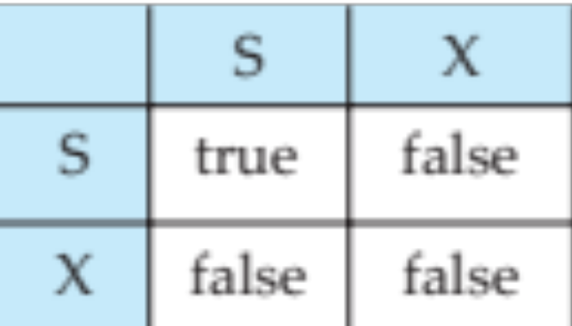
Figure 15.01

Slide 39
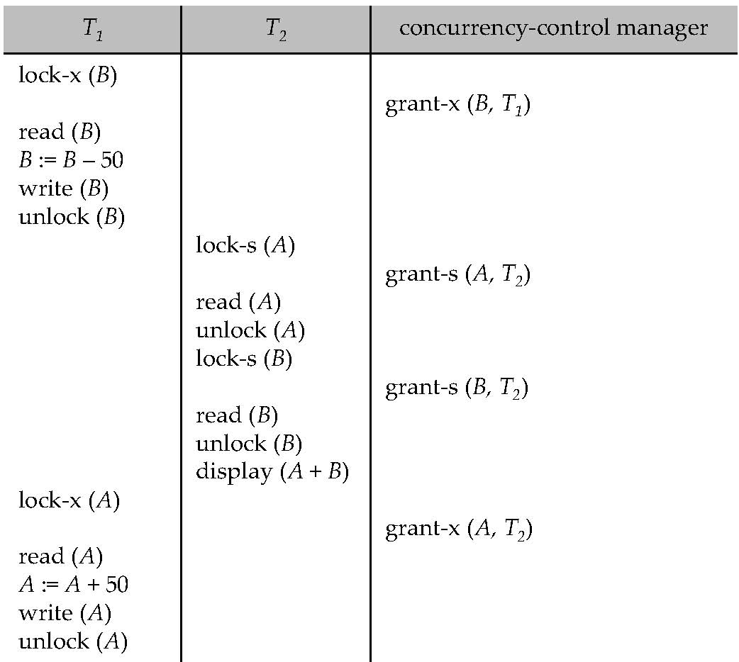
Figure 15.04

Slide 40
Figure 15.07

Slide 41
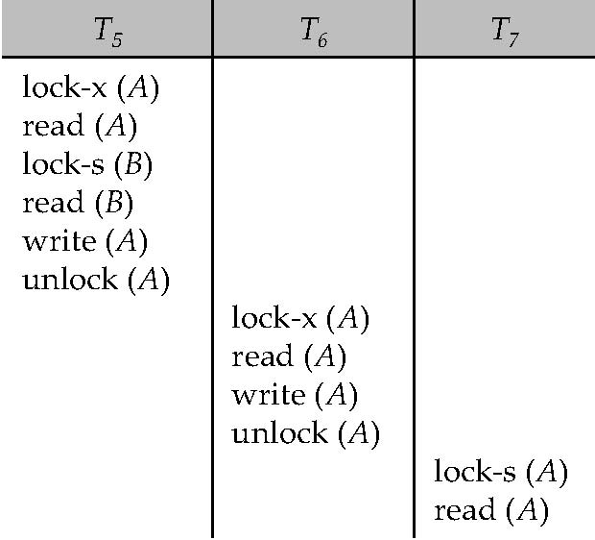
Figure 15.08

Slide 42
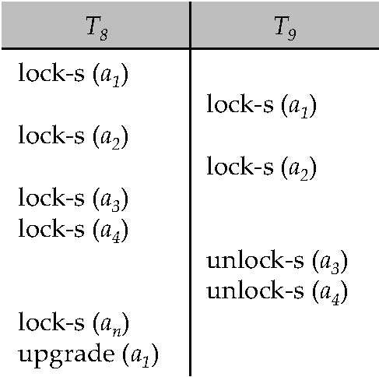
Figure 15.09

Slide 43
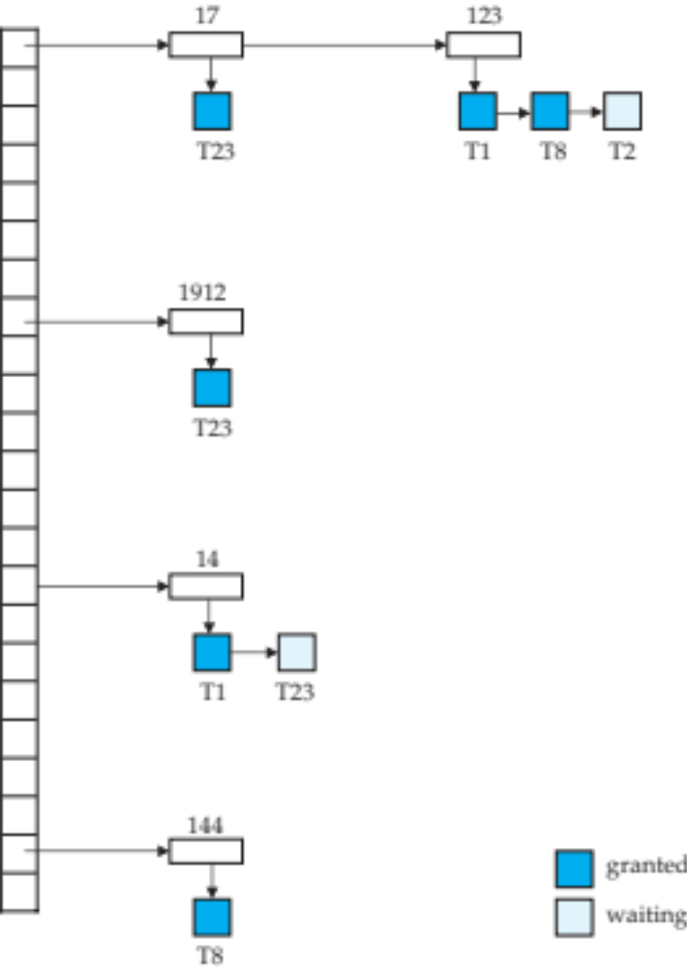
Figure 15.10

Slide 44

Figure 15.11

Slide 45
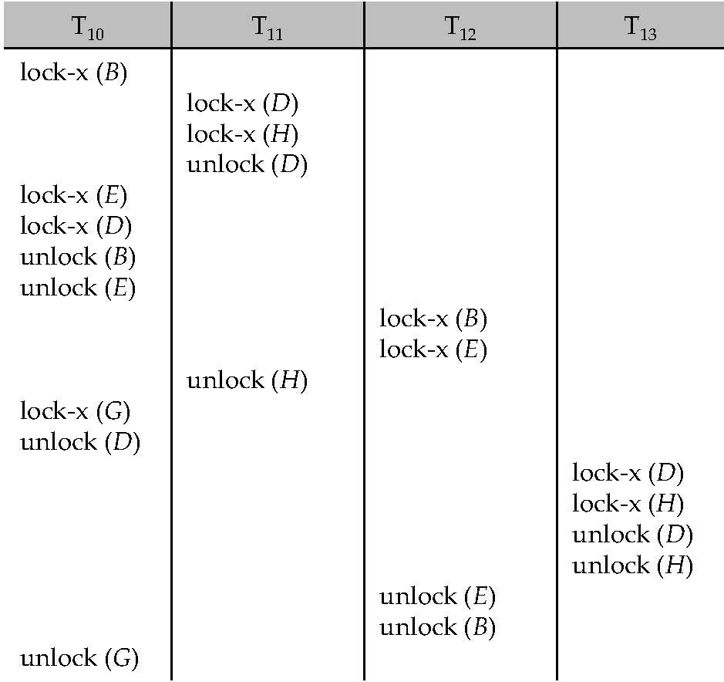
Figure 15.12

Slide 46
Figure 15.13

Slide 47
Figure 15.14

Slide 48

Figure 15.15

Slide 49

Figure 15.16

Slide 50
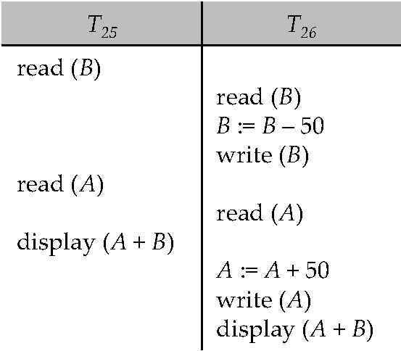
Figure 15.17

Slide 51
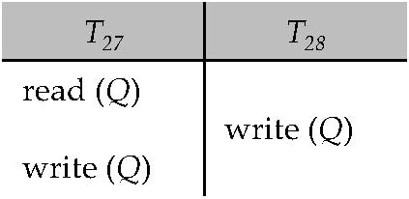
Figure 15.18

Slide 52
Figure 15.19

Slide 53
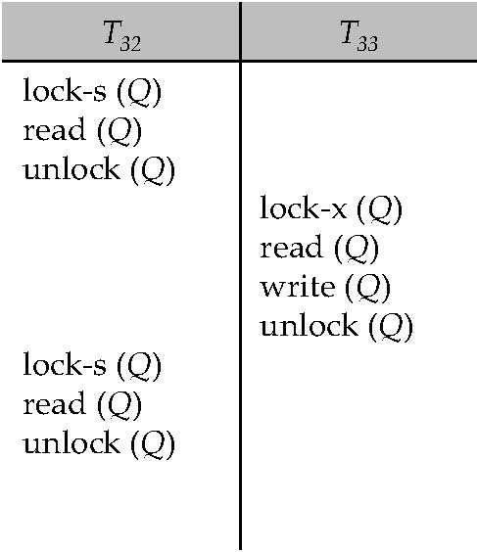
Figure 15.20

Slide 54
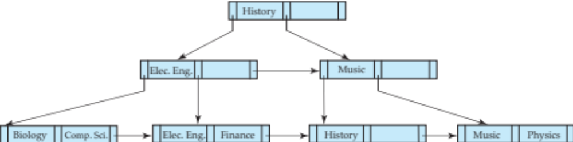
Figure 15.21

Slide 55
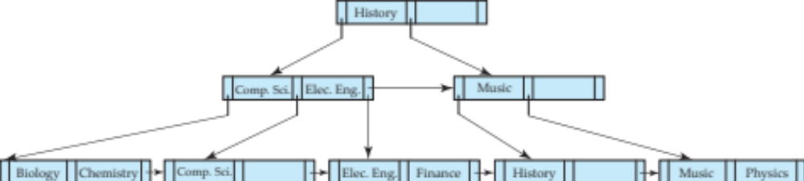
Figure 15.22

Slide 56
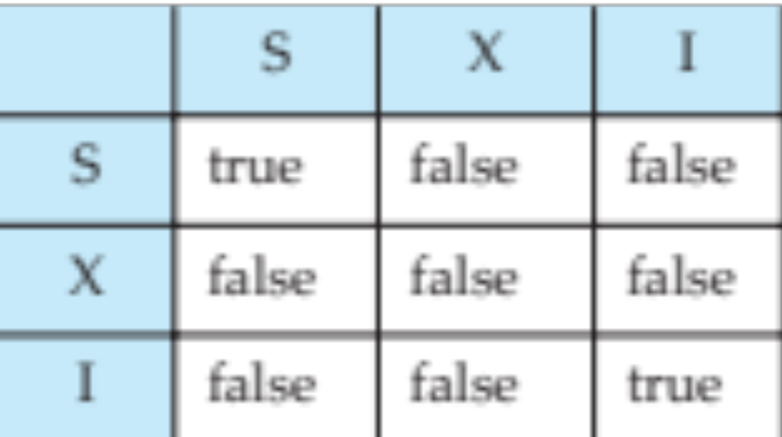
Figure 15.23

Slide 57
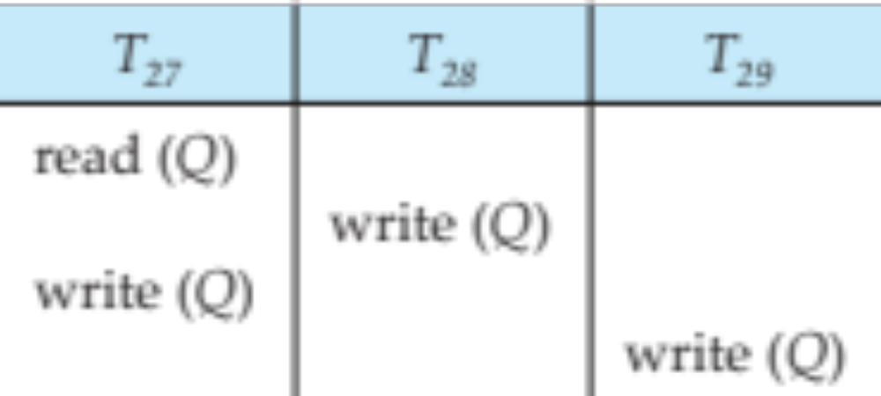
Figure in-15.1

